Slide 1
Project Status
GPS Jammer Detection

Slide 2
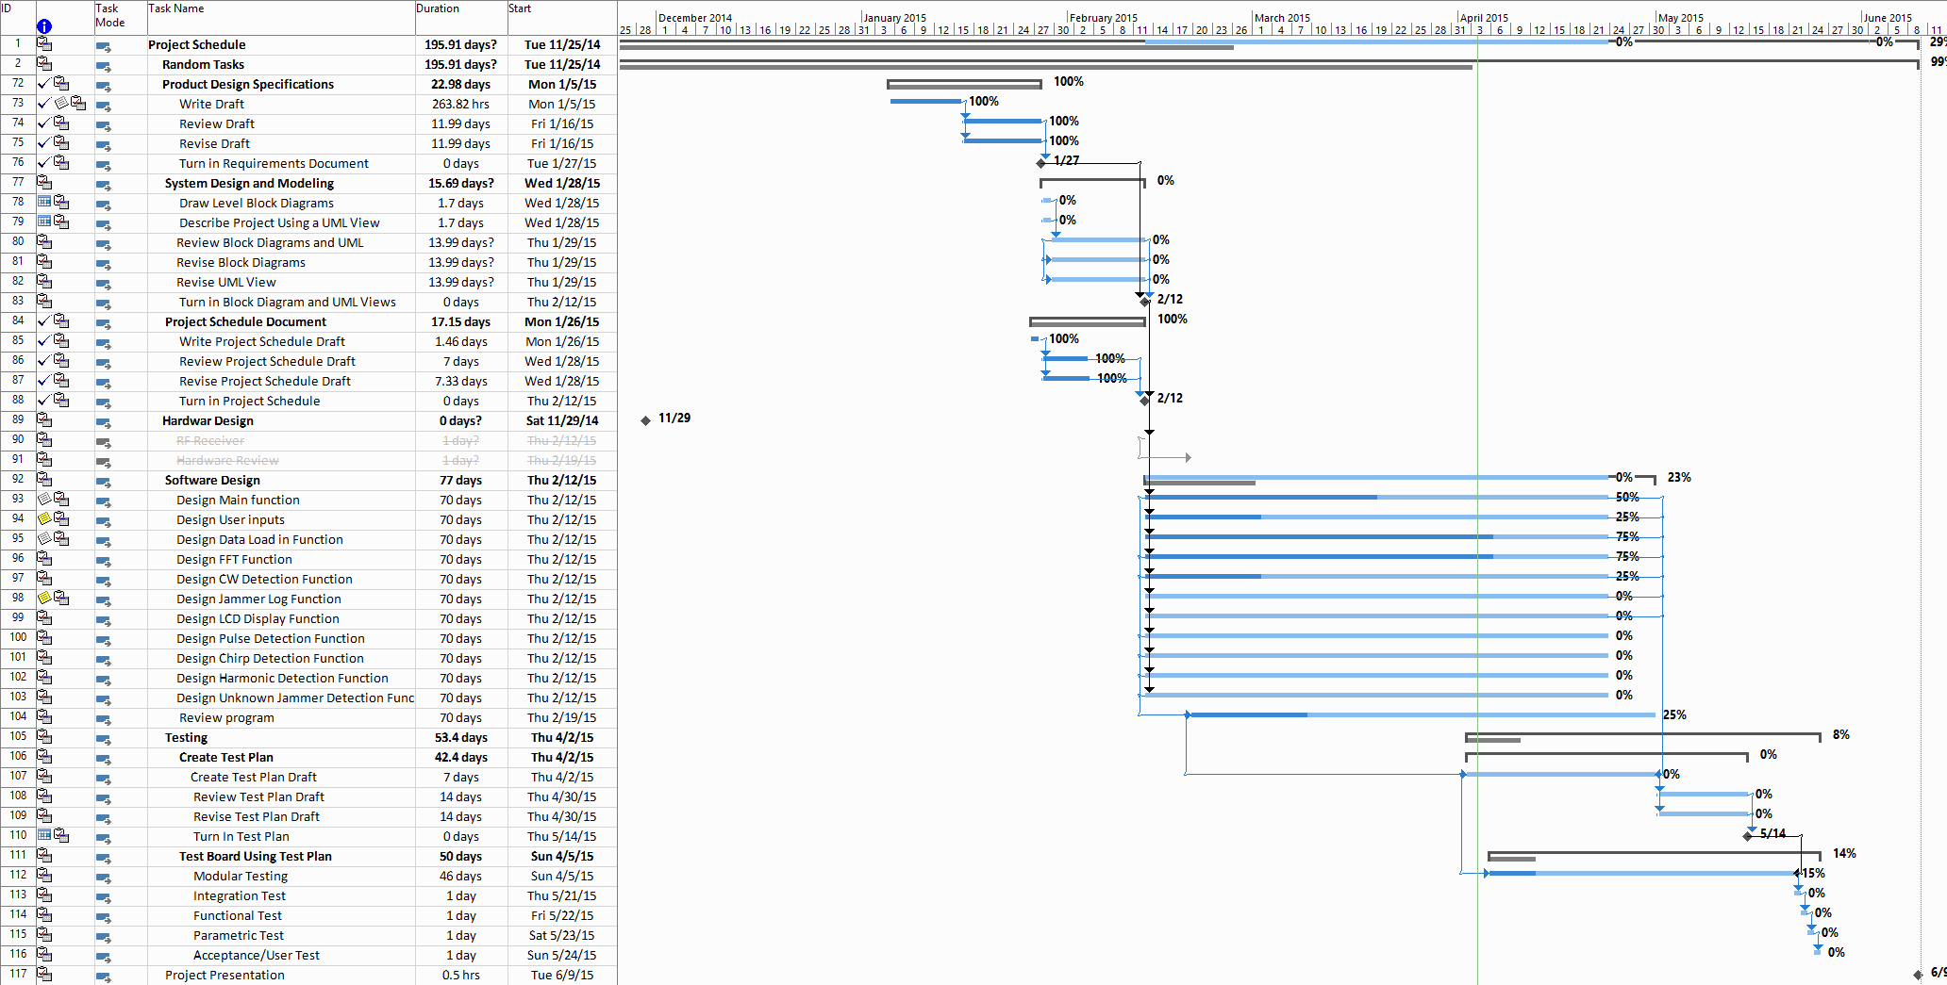
Project Schedule
Notes:
Is the project on time
List issues that cause the project to be falling behind schedual

Slide 3
Bill of Materials
Notes:
Project estimated cost
Items that need to be ordered and delivery date.

Slide 4
Attention Areas
List delays and problems since last status update was given
List corrective actions being taken
Address schedule implications
Make sure you understand
Issues that are causing delays or impending progress
Why problem was not anticipated
If customer will want to discuss issue with upper management

Slide 5
Deliveries
List main critical deliverables
Yours to client
Yours to outside services
Outside services to you
Other departments to you
Understand your confidence rating to each deliverable
Indicate confidence level on slides if appropriate

Slide 6
Definition:
Jamming Signals: signals are continuous presenting more than on second and with transmitted power is greater than -60dBm to be an effective jamming signals.
Chirp Signal: A chirp is a signal in which the frequency increases ('up-chirp') or decreases ('down-chirp') with time and repeats periodically.
Continuous Wave: A signal with constant amplitude and frequency.
Note: If multi-frequency jammers transmitted signals characterized by the same sweep period in each frequency band. This considers to be that a single local oscillator is used for the generation of all the signals.

Slide 7
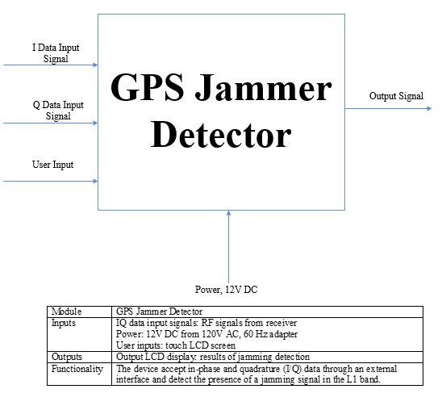
GPS Jammer Detector

Slide 8
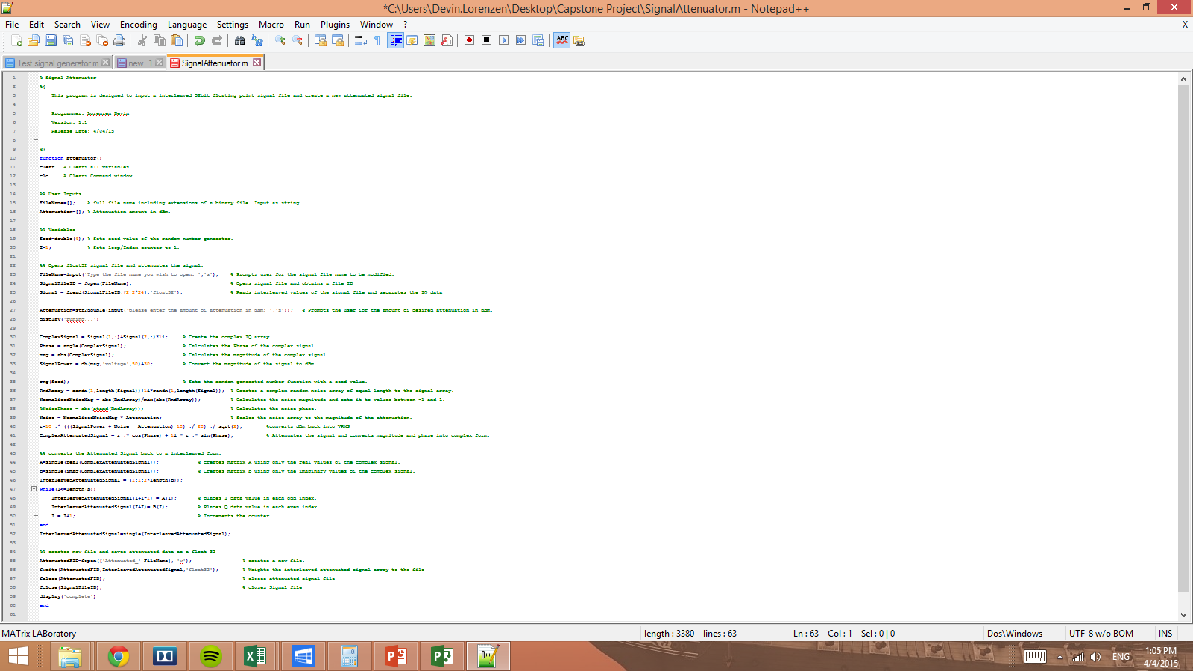
Attenuator Program

Slide 9
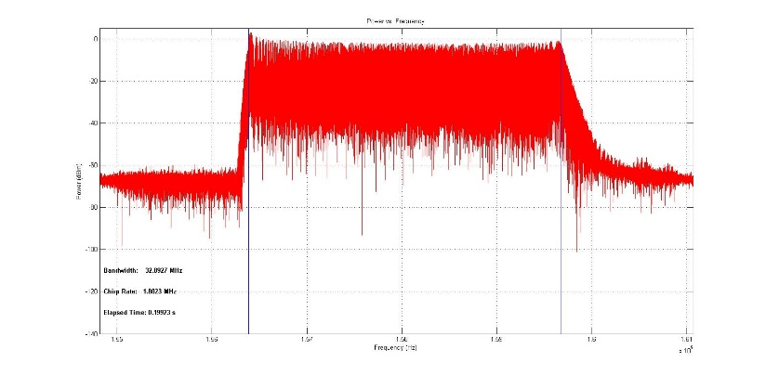
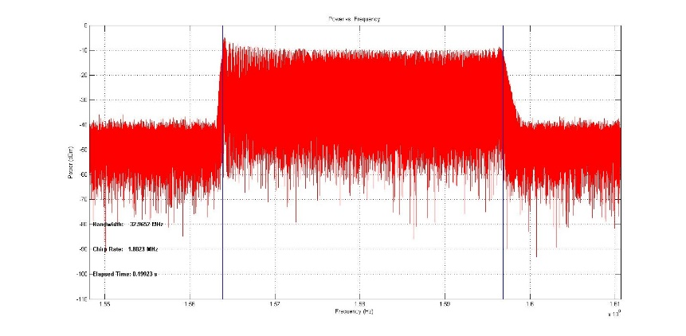
Attenuation 0 dBm vs 10 dBm
0 dBm Attenuation
10 dBm Attenuation

Slide 10
Technology
List technical problems that have been solved
List outstanding technical issues that need to be solved
Summarize their impact on the project
List any dubious technological dependencies for project
Indicate source of doubt
Summarize action being taken or back up plan

Slide 11
Resources
Summarize project resources
Dedicated (full-time) resources
Part-time resources
If project is constrained by lack of resources, suggest alternatives
Understand that customers may want to be assured that all possible resources are being used, but in such a way that costs will be properly managed

Slide 12
Goals for Next Review
Date of next status update
List goals for next review
Specific items that will be done
Issues that will be resolved
Make sure anyone involved in project understands action plan

